Slide 1
Investigating Swirl and Tumble Flow with a Comparison of Visualization Techniques
Carly Costello

Slide 2
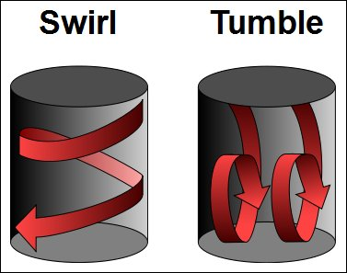

Slide 3
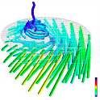
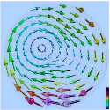
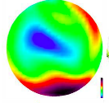
Swirl flow motion on 2D slices
Geometric flow visualization
Direct visualization

Slide 4
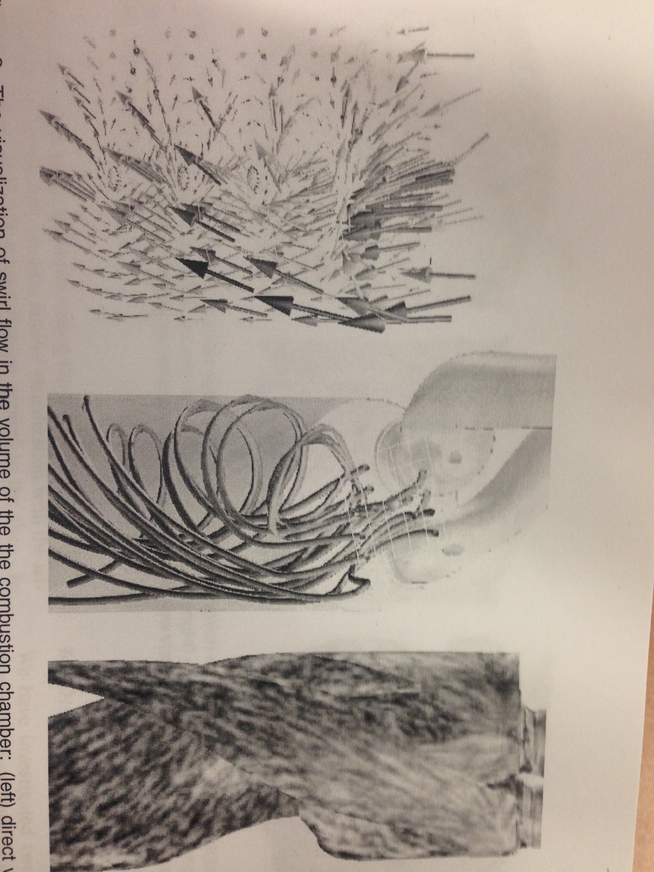
Tumble flow in 3D Slices
Direct Geometric Texture -based

